Slide 1
Web Application Frameworks
Dr. Damitha Karunaratna
Head of Department of Computing

Slide 2
Prerequisites
Knowledge on HTML,PHP, JavaScripts, CSS
Knowledge on SQL (MySQL)
Knowledge on client-server architecture
Edit programs by using Visual Studio Code

Slide 3
What is a web (application) framework
A Software framework is a reusable model with common code providing generic functionality that can be selectively overridden or specialized by user code to provide specific functionality.
Software frameworks have distinguishing features that separate them from libraries or normal user applications:
Inversion of control - The overall flow of control of programs is dictated by the framework
Default behavior - A framework has a default behavior which can be changed by user code .
Extensibility - A framework can be extended by overriding the default behavior.
Non-modifiable framework code - The framework code, in general, is not allowed to be modified. Users can extend the framework, but not modify its code.
Conventions – filename, folder structure
https://en.wikipedia.org/wiki/Software_framework

Slide 4
Software libraries Vs Frameworks
A software library provides a set of reusable functions/objects/modules that can be used in application development. Libraries typically focus on a narrow scope so their API’s also tend to be smaller and require fewer dependencies.
A software framework is a software model which can be used as a template to develop software applications.

Slide 5
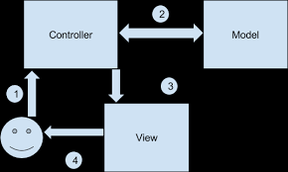
Model View Controller (MVC) design pattern
MVC based application comprises of three main components.
Model
View
Controller
Model : Represents the data used by the application
View : Defines User Interface of the application
Controller : contains application logic
Blade
google.com/search?q=mvc+design+pattern&rlz=1C1CHBD_enLK873LK873&tbm=isch&source=iu&ictx=1&fir=3vzFWTQ7CdsnRM%253A%252CsT4sMGZwFj_sQM%252C_&vet=1&usg=AI4_-kQ1J_ZSTMgszWgFLNLahs0bVPZsNg&sa=X&ved=2ahUKEwiW-taLsa3nAhURfisKHW_EBtkQ_h0wG3oECAkQBQ#imgrc=B9fauRieN73zTM:&vet=1

Slide 6
Popular Web based Frameworks
Ruby on Rails - Ruby based
Django – Python based
Express – Javascript
ASP.net – C#
Laravel – PHP
Yii - PHP
Play – Java and Scala
CodeIgniter - PHP

Slide 7
Laravel
Laravel is an Open Source framework.
It provides a rich set of features to develop Web Applications fast.
Pre-requisite :
Familiarity with HTML and PHP
Familiarity with Apache web server

Slide 8
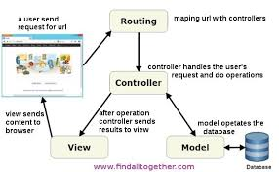
Laravel Architecture
Eloquent
Blade
https://www.google.com/search?q=laravel+architecture&rlz=1C1CHBD_enLK873LK873&tbm=isch&source=iu&ictx=1&fir=WAmT1eonl1C3qM%253A%252C1Uxowo4_dPVGRM%252C_&vet=1&usg=AI4_-kSv25QYp26aMz02hD7BJ9EMELTSCg&sa=X&ved=2ahUKEwilrLXqs63nAhWBeX0KHchqBBwQ9QEwAHoECAYQAw#imgrc=_&vet=1

Slide 9
Installation on Windows platform
Laravel uses composer to manage dependencies. Download and install composer.
https://getcomposer.org/download/
Check the composer installation by typing the following command at the command line.
composer
Clone the Laravel to your system
composer global require laravel/installer

Slide 10
Installation on Windows platform
Add the following path to your $PATH system environment variable so the laravel executable can be located by your system.
%USERPROFILE%\AppData\Roaming\Composer\vendor\bin
Type the following command to check your installation
laravel
create a fresh Laravel application in the directory you specify (example app_name)
laravel new app_name
This command will creating a folder structure for your application

Slide 11
Starting the Laravel server
move to the app folder and type the following command.
php artisan serve
This command starts a server at the port 8000
Open a web browser and type the url
localhost:8000
you will see the default index page of your project

Slide 12
Important folders
app: This directory contains the core code of the application.
bootstrap: This directory contains the application bootstrapping script.
config: This directory contains configuration files of application.
database: This folder contains your database migration and seeds.
public: This is the application’s document root. It starts the Laravel application. It also contains the assets of the application like JavaScript, CSS, Images, etc
storage: This directory contains App storage, like file uploads etc.
vendor: This directory contains composer dependencies.

Slide 13
app folder
There are many folders inside the app folder. The Http sub-folder contains all your controllers, filters, and requests.

Slide 14
Important files
.env file in the application main folder store important data about various parameters.
APP_KEY - Application key to secure session and other encrypted data of the application.
Changing the database parameters
Goto mysql and create a new database (say project)
Change the parameters in the .env as appropriate.
DB_CONNECTION=mysql
DB_HOST=127.0.0.1
DB_PORT=3306
DB_DATABASE=project
DB_USERNAME=root
DB_PASSWORD=root1234

Slide 15
Laravel persistence data
Laravel allows you to store data in any popular DB.
It manage data stored in any database through a database layer called Eloquent.
Eloquent provides a single uniform API to manage data stored in a variety of DBMSs.

Slide 16
HTTP Methods
The Hypertext Transfer Protocol (HTTP) enables communication between clients and servers over the Internet. It works as a request-response protocol between a client and server.
In HTTP a client can request a service from a server by using the following methods.
GET
POST
PUT
HEAD
DELETE
PATCH
OPTIONS

Slide 17
HTTP Methods
The Hypertext Transfer Protocol (HTTP) enables communication between clients and servers over the Internet. It works as a request-response protocol between a client and server.
In HTTP a client can request a service from a server by using the following methods.
GET : request data from a specified resource. The query string (name/value pairs) is sent in the URL of a GET request.
Example : /app/form1.php?name1=value1&name2=value2
POST : used to send data to a server to create/update resources.
The data sent to the server is stored in the request body of the HTTP request:

Slide 18
Web Routing
Web routine is a mechanism used to map a Web URI with a controller.
In Laravel these binding are defined in a file named routes/web.php
Route::get('/', function () {
return view('welcome’);
});
This means : When a get request is made to the home page of the application (‘/’) the view with the name “welcome” should be returned.
Typically view of the application are stored in the folder resources/views and have the .blade.php extension. The extension is to inform Laravel that the templates should be process by the “Blade” template engine.

Slide 19
Web Routing
Modified the routes/web.php as below.
Route::get('/', function () {
return “My output”;
});
Reload the uri http://localhost:8000/ to see the effect of the modification.

Slide 20
Web Routing
Add the following code to the end of file routes/web.php .
Route::get(‘contact', function () {
return “My contacts”;
});
Reload the uri http://localhost:8000/contact to see the effect of the modification.

Slide 21
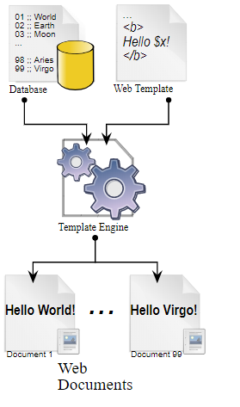
Web Template engines
web template engines enable web designers and developers to generate dynamic web pages from web templates by inserting data retrieved from data sources into web templates.
Laravel use the Blade template engine to generate dynamic web pages
https://en.wikipedia.org/wiki/Web_template_system

Slide 22
Crating a web template
Create the following web template in the resources/views folder with the name contact.blade.php
<h1> Contact </h1>
<p> Informatics Institute of Technology </p>
<p> email : iit@iit.ac.lk </p>

Slide 23
Crating a web template
Modify the file routes/web.php as below
Route::get(‘contact', function () {
return view(“contact”);
});
Reload the uri http://localhost:8000/contact to see the effect of the modification.
Note that no file extension is added

Slide 24
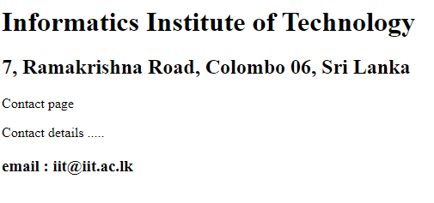
Quiz
Create three web pages
Home page
Contact Page
About page
Add the pages to the routes/web file
Contact page
About page

Slide 25
Quiz
<h1> Informatics Institute of Technology </h1>
<h2> 7, Ramakrishna Road, Colombo 06, Sri Lanka </h2>
<p> Contact page </p>
Contact details .....
<h3> email : iit@iit.ac.lk </h3>
routes/web file
Route::get('/', function () {
return view('welcome');
});
Route::get('contact', function () {
return view("contact");
});
Route::get('about', function () {
return view("about");
});
Contact page
<h1> Informatics Institute of Technology </h1>
<h2> 7, Ramakrishna Road, Colombo 06, Sri Lanka </h2>
<p> about page </p>
About details .....
<h3> email : iit@iit.ac.lk </h3>
About page

Slide 26
Quiz
routes/web file can be simplified as below
Route::get('/', function () {
return view('welcome');
});
Route::get('contact', function () {
return view("contact");
}); Route::get('about', function () {
return view("about");
});

Slide 27
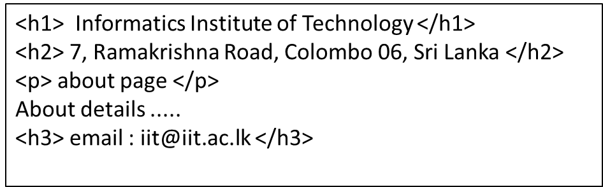
Template Inheritance
<h1> Informatics Institute of Technology </h1>
<h2> 7, Ramakrishna Road, Colombo 06, Sri Lanka </h2>
<p> Contact page </p>
Contact details .....
<h3> email : iit@iit.ac.lk </h3>
Some Data in both templates are replicated. Can be eliminate this replication??

Slide 28
Template Inheritance
master.blade.php
<html>
<title> </title>
<body>
<h1> Informatics Institute of Technology </h1>
<h2> 7, Ramakrishna Road, Colombo 06, Sri Lanka </h2>
@yield('content')
<h3> email : iit@iit.ac.lk </h3>
@yield(‘footer’)
</body>
</html>
contact.blade.php
about.blade.php
@extends('master')
@section('content')
<p> Contact page </p>
Contact details .....
@endsection
@section(‘footer’)
<p> This is my footer </p>
@endsection
@extends('master')
@section('content')
<p> about page </p>
About details .....
@endsection

Slide 29
Organize views in folders
Route::get('/', function () {
return view('welcome');
});
Route::get('contact', function () {
return view(“home.contact");
}); Route::get('about', function () {
return view(“home.data.about");
});
In resources/views folder
resources/views/welcome.blade.php
In resources/views/home folder
resources/views/home/contact.blade.php
In resources/views/home/data folder
resources/views/home/data/about.blade.php

Slide 30
Passing values to template
Route::get('contact', function () {
return view(“home.contact“,[“title”=>”Content Page”]);
});
contact.blade.template
<@extends('master')
@section('content')
<p> <?php
echo $title;
?>
</p>
Contact details .....
@endsection
<@extends('master')
@section('content')
<p> {{ $title }} </p>
Contact details .....
@endsection

Slide 31
Passing arrays to template
Route::get('contact', function () {
$names = [“namal”,”saman”,”john”];
return view(“home.contact“,[“contacts”=>$names]);
});
contact.blade.php
<h1> Informatics Institute of Technology </h1>
<h2> 7, Ramakrishna Road, Colombo 06, Sri Lanka </h2>
<p> Contact page </p>
Contact details .....
<ul>
@foreach($contacts as $item)
<li> {{ $item }} </li>
@endforeach
</ul>
<h3> email : iit@iit.ac.lk </h3>

Slide 32
Using your css and Javscript files
Create two folders in the public folder of your app with the name css and js.
Save all your css and Javascript files in the css and js folders.
You could use your css and Javascript files by including the following as appropriate in the header section of your views.
<link rel="stylesheet" type="text/css" href="{{ asset(‘css/style.css') }}">
<script type="text/javascript" src="{ { asset('js/jquery.js') } }"></script>
Download bootstrap from the site at https://getbootstrap.com/docs/4.0/getting-started/download/
Copy bootstrap.min.js and bootstrap.min.css files to the js and css folders of your app

